Slide 1
Introduction to Computer Networks (CS156)
Installation of Packet Tracer
Dr. Htet Ne Oo
Department of Computer Science and Engineering,
Chitkara University, Punjab

Slide 2
Steps for Registration and Download
1. Create an account in Netacad: www.netacad.com
If already having account, then log in.
May be you do not remember password, then click forgot password and reset.
2. Go to resources, then go to Packet Tracer.
3. Download and install Packet tracer according to your Operating System. (Current version: 8.2)

Slide 3
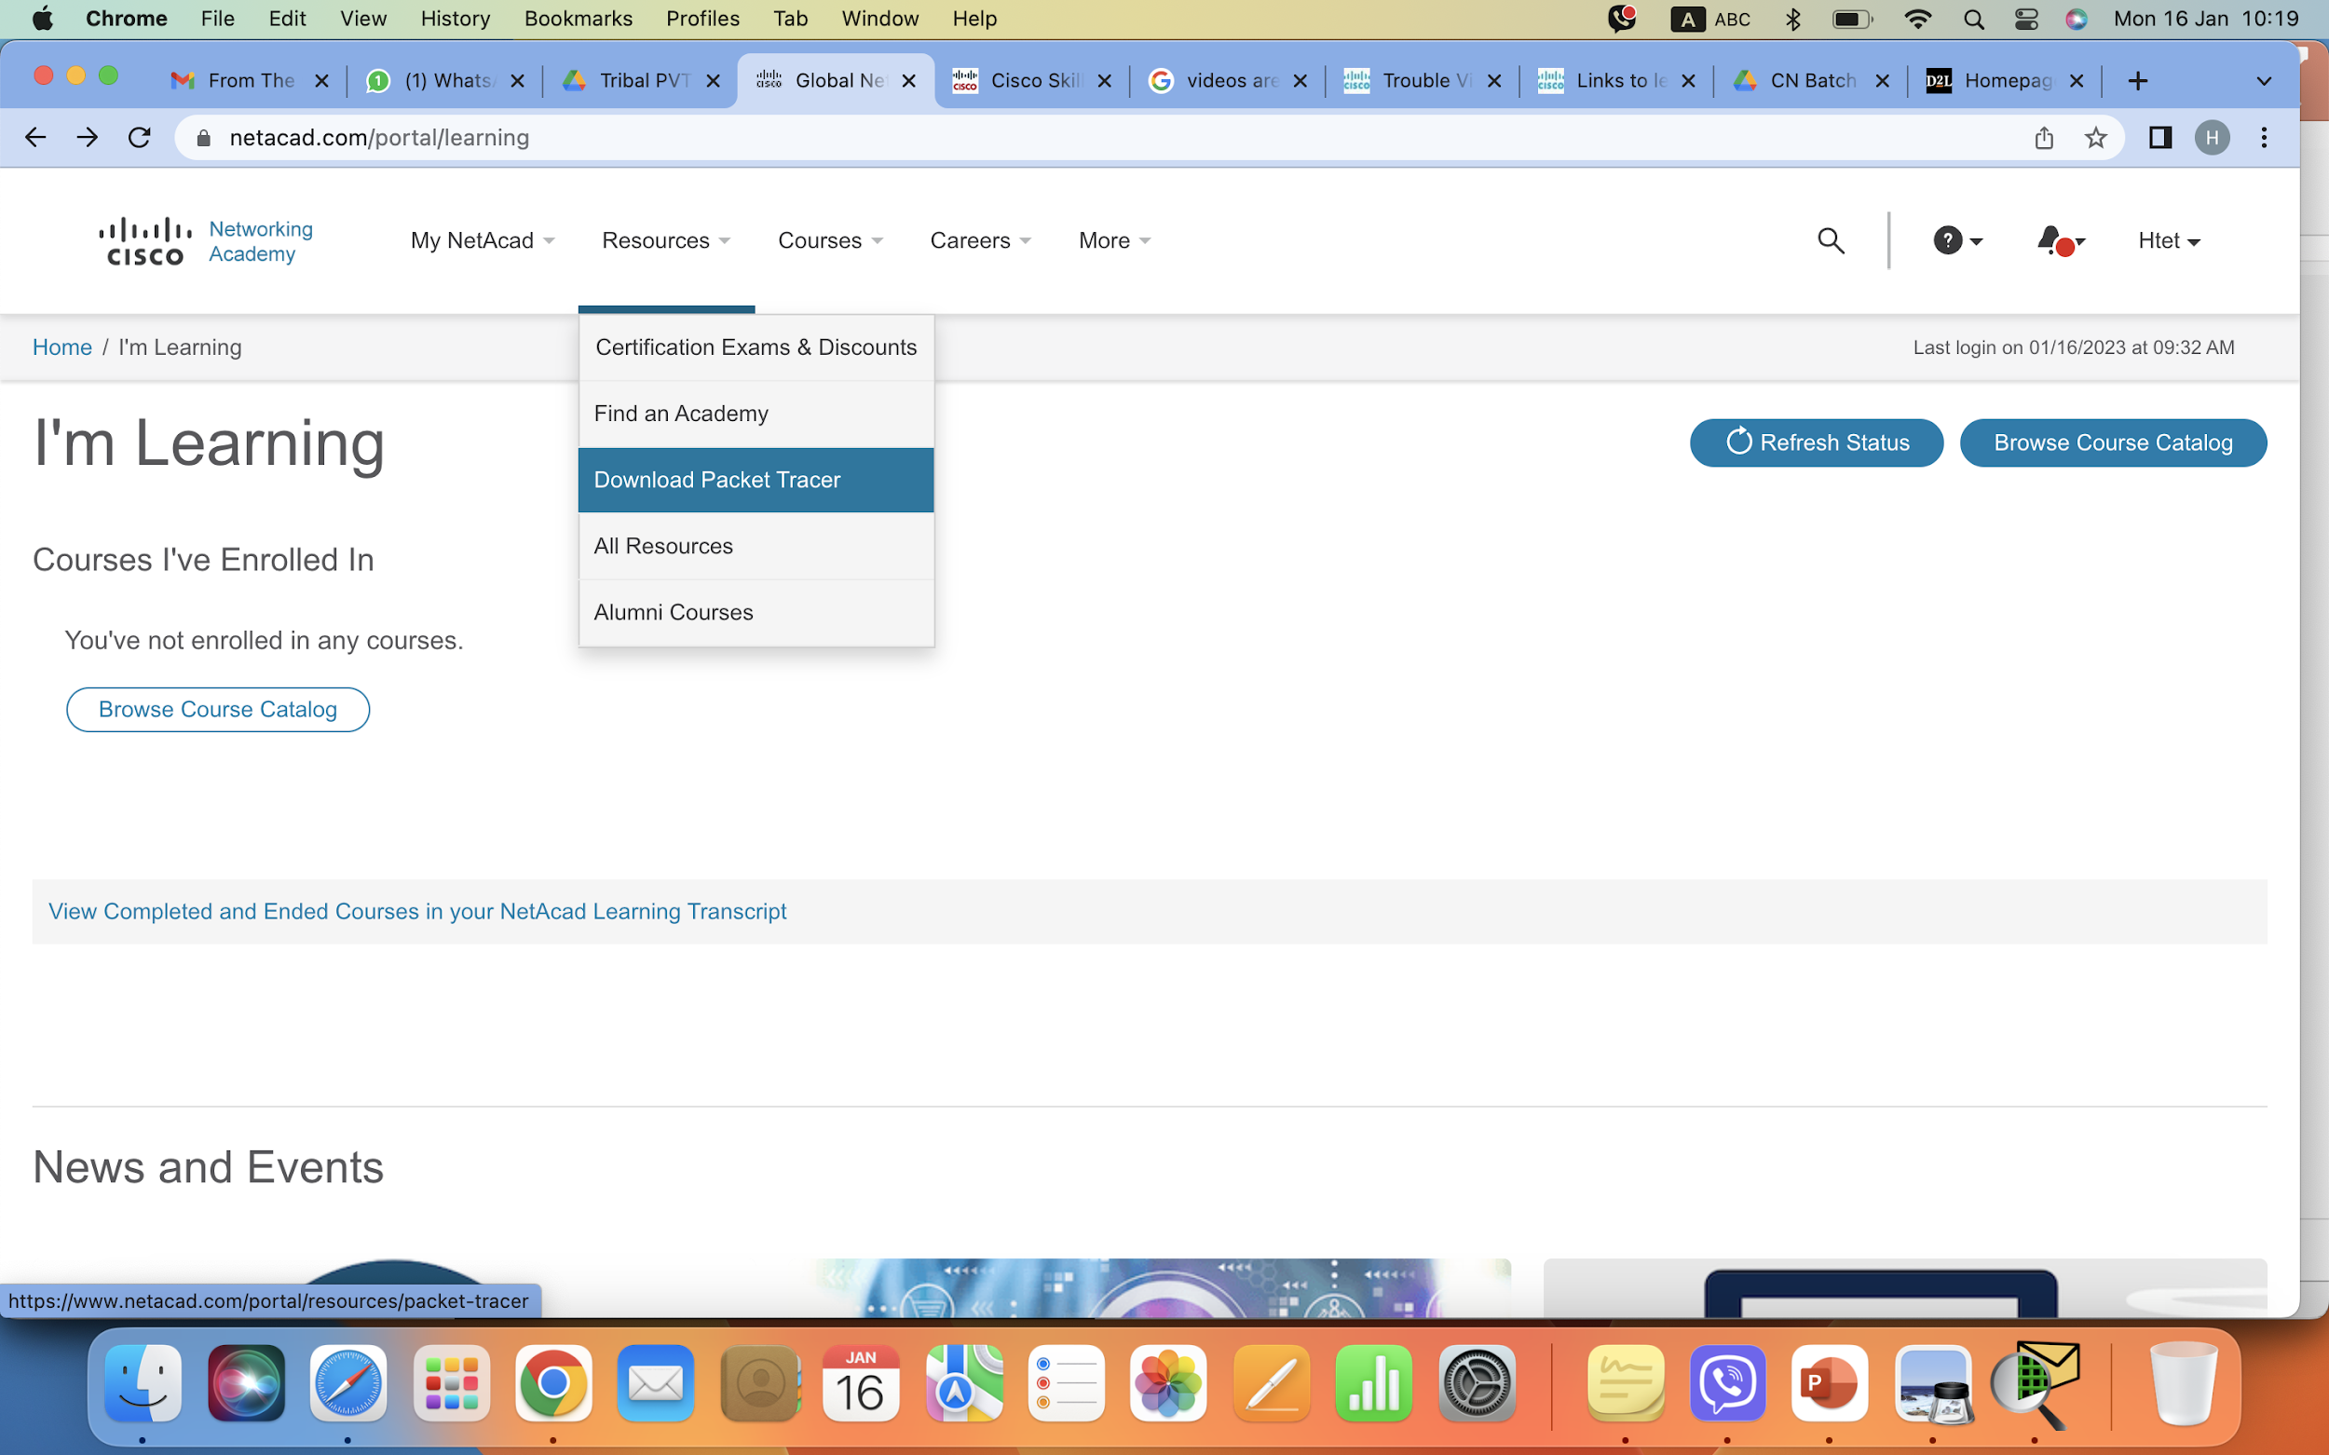
Steps for Registration and Download

Slide 4
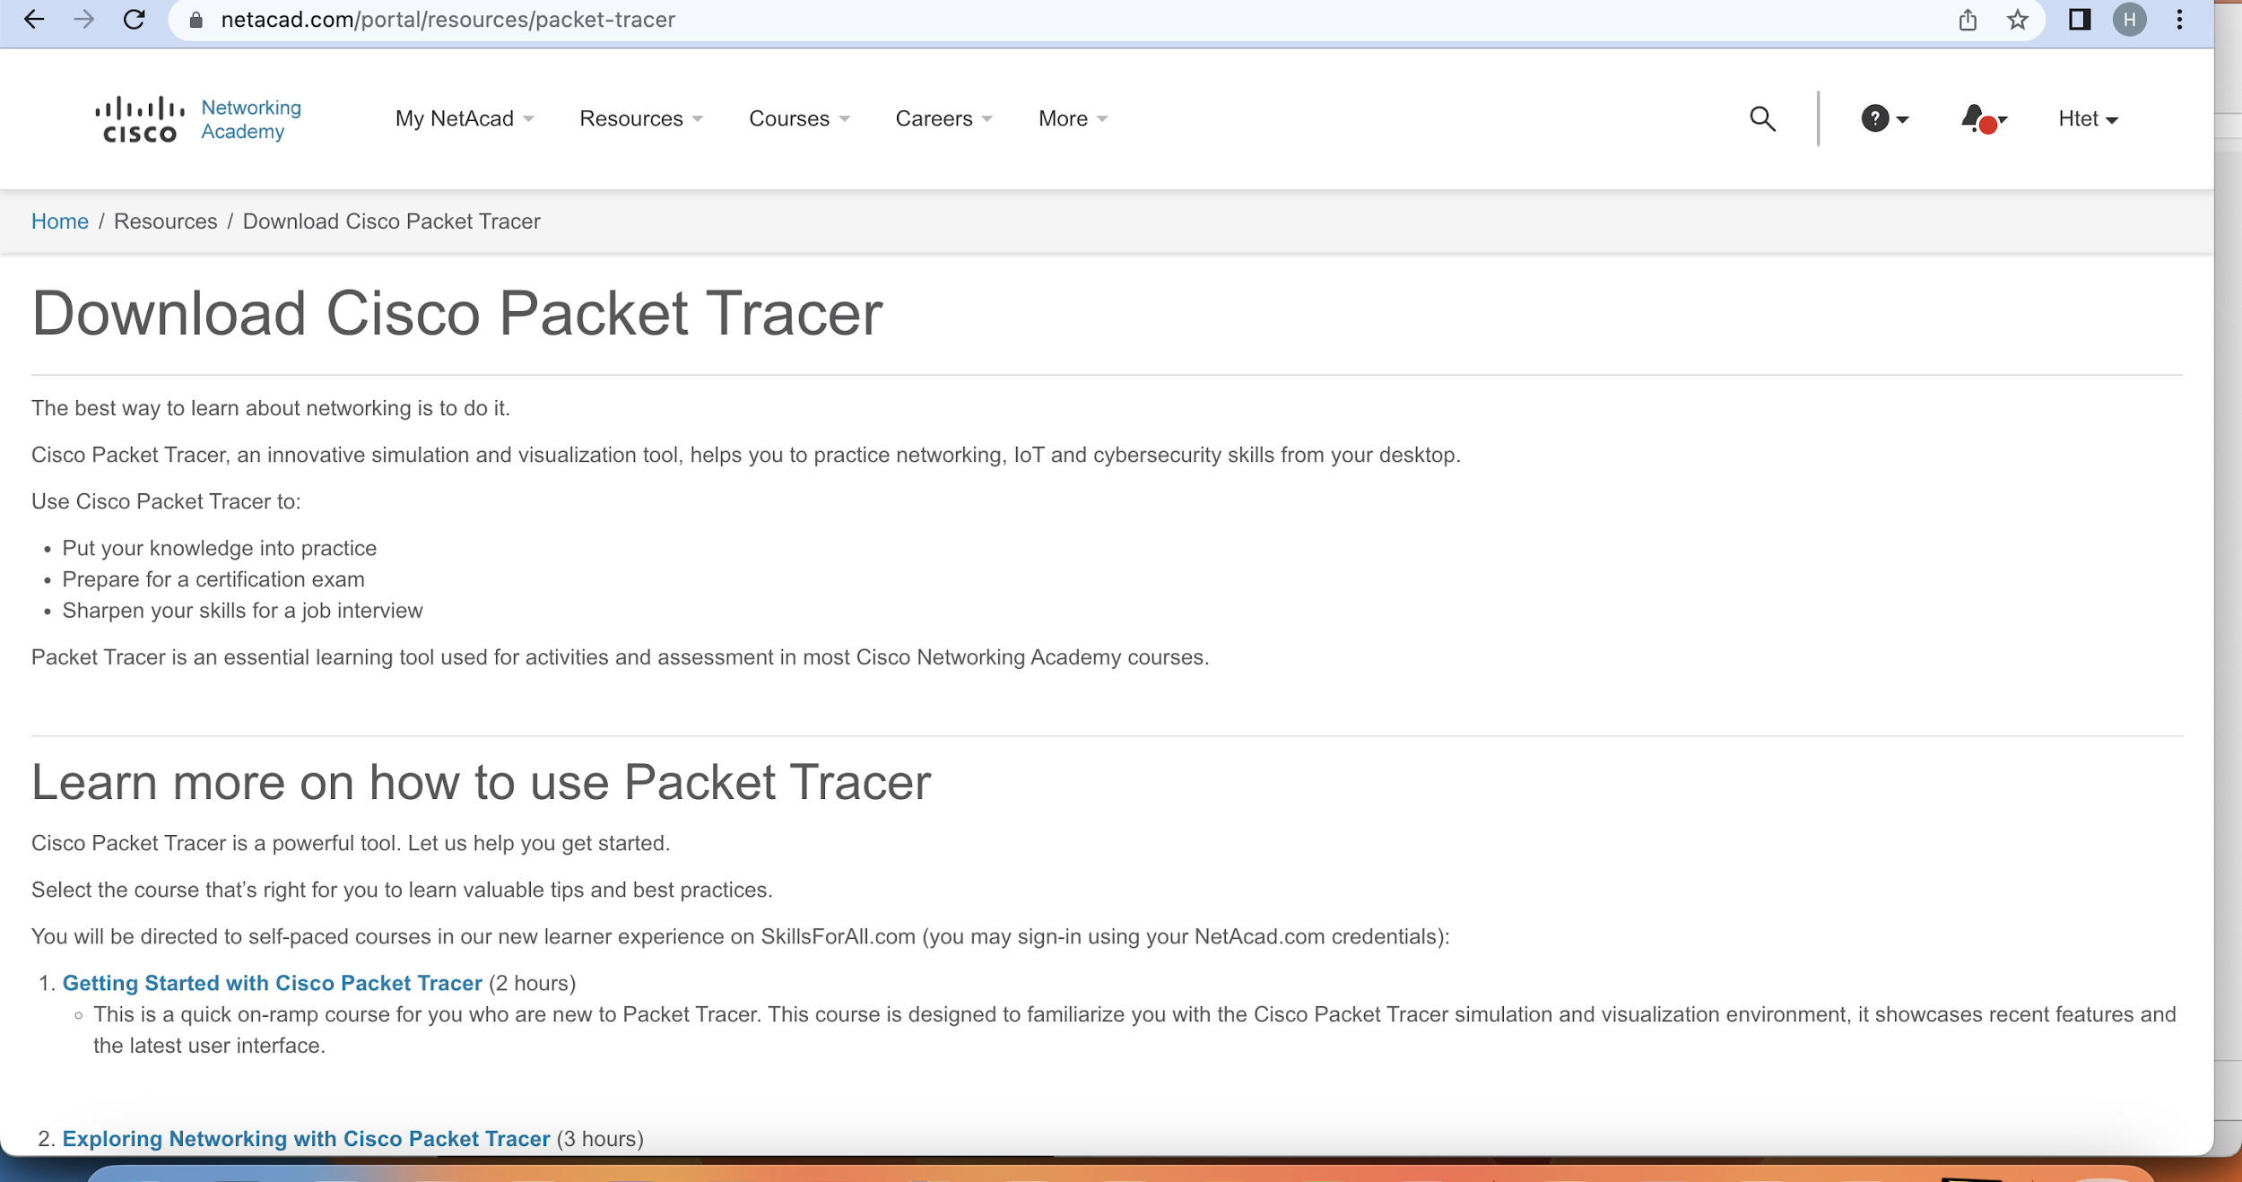
Steps for Registration and Download

Slide 5
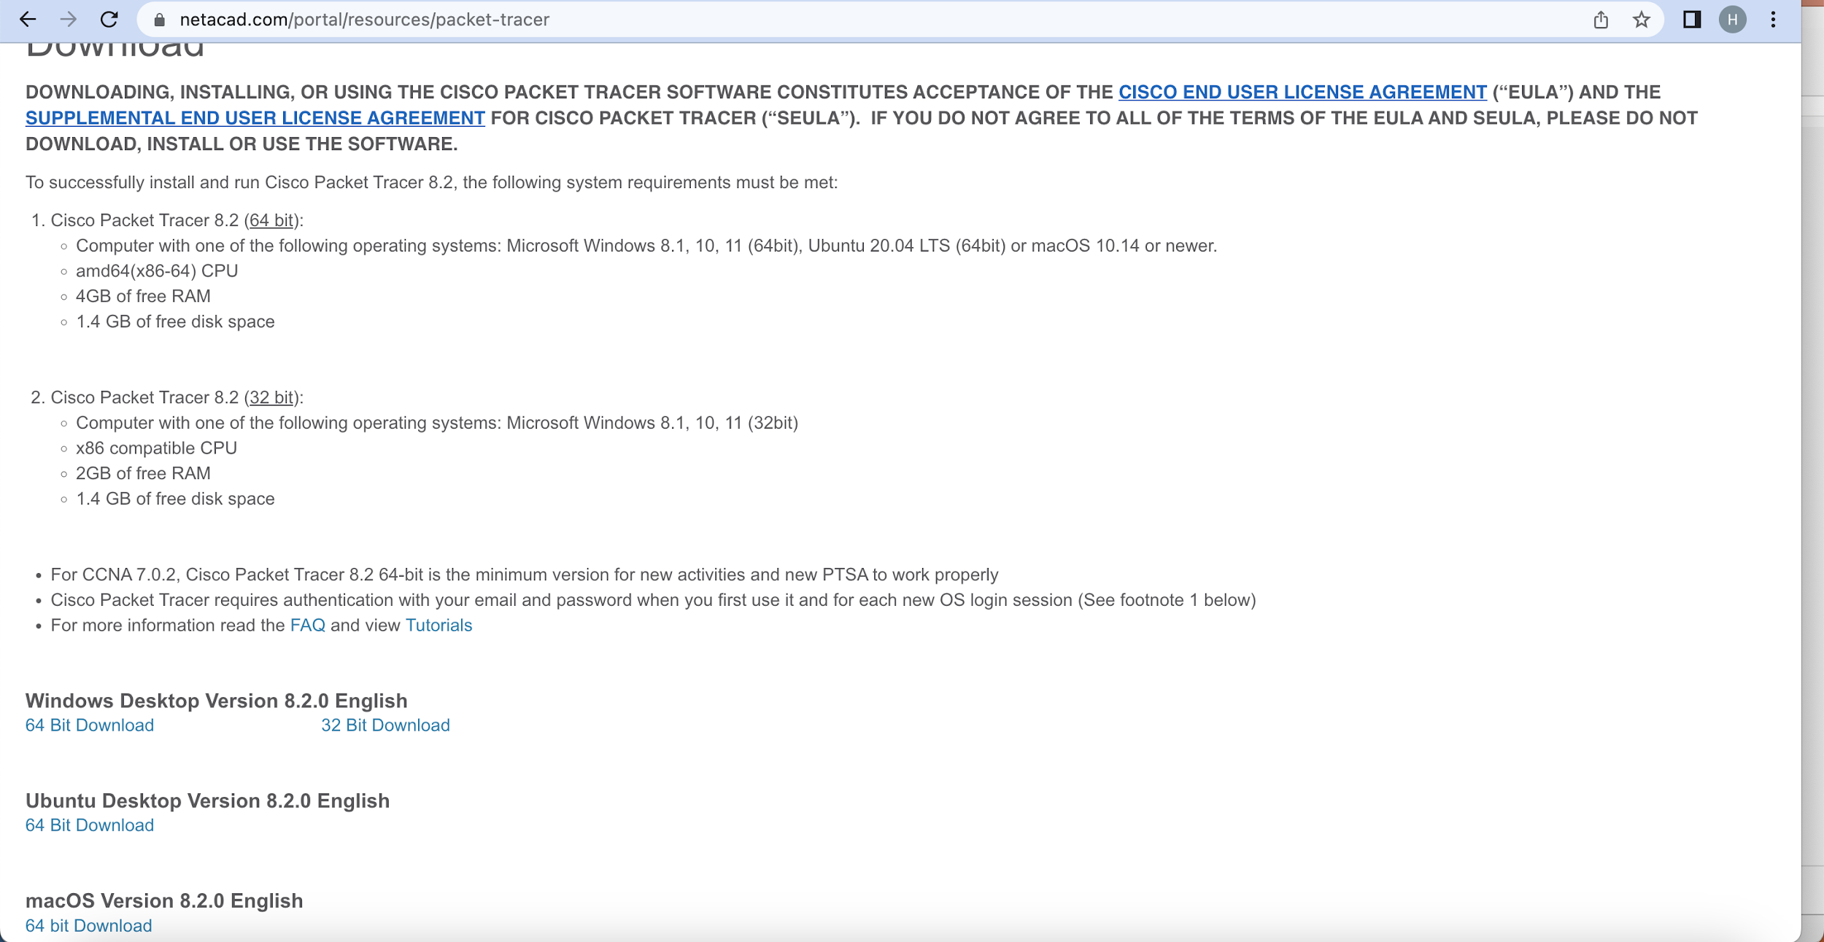
Steps for Registration and Download

Slide 6
Log in
Start Packet Tracer in your system
Log in with netacad credentials
If it is Only Guest Log in, it does not allow to save more than 3 files.
After log in, it will keep you for 3 months log in.

Slide 7
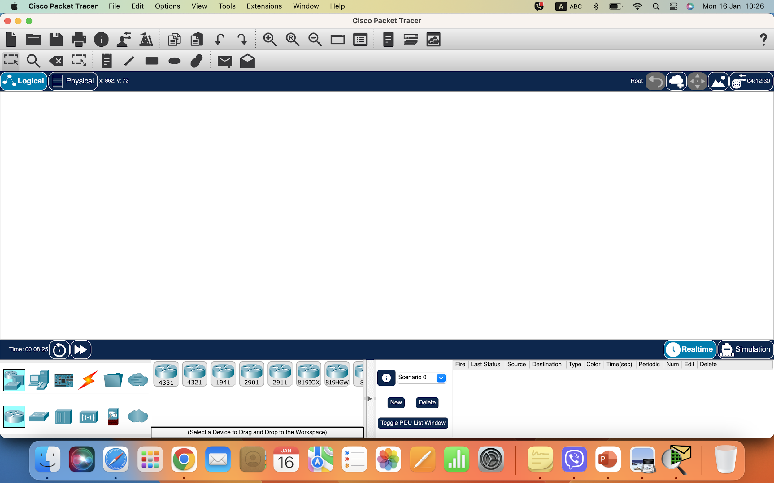
Packet Tracer Interface

Slide 8
Courses
Go back to www.netacad.com and log in
Go to Courses
Packet Tracer
Getting started with Packet Tracer (2 Hours)

Slide 9
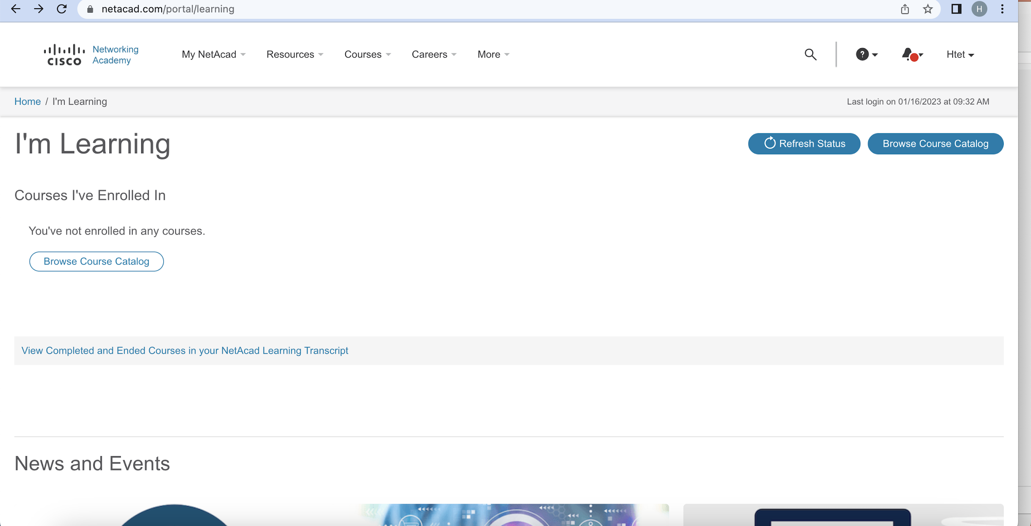
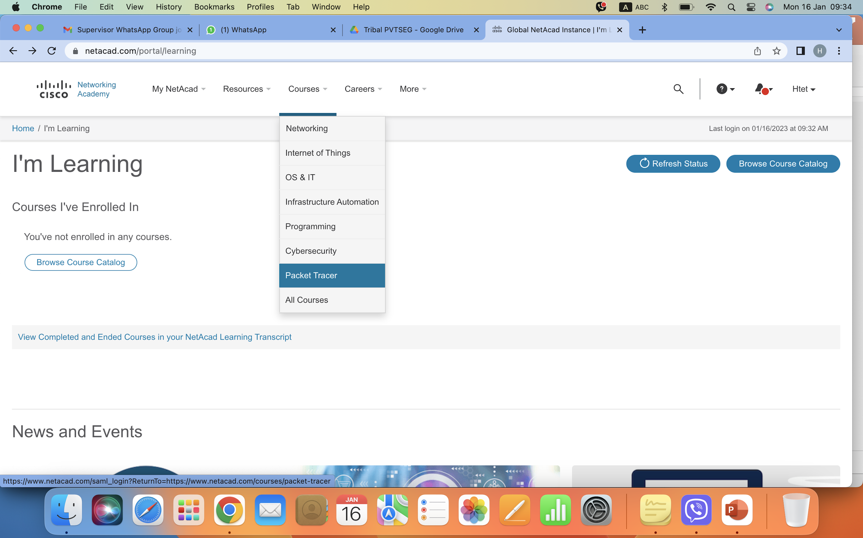
Courses

Slide 10
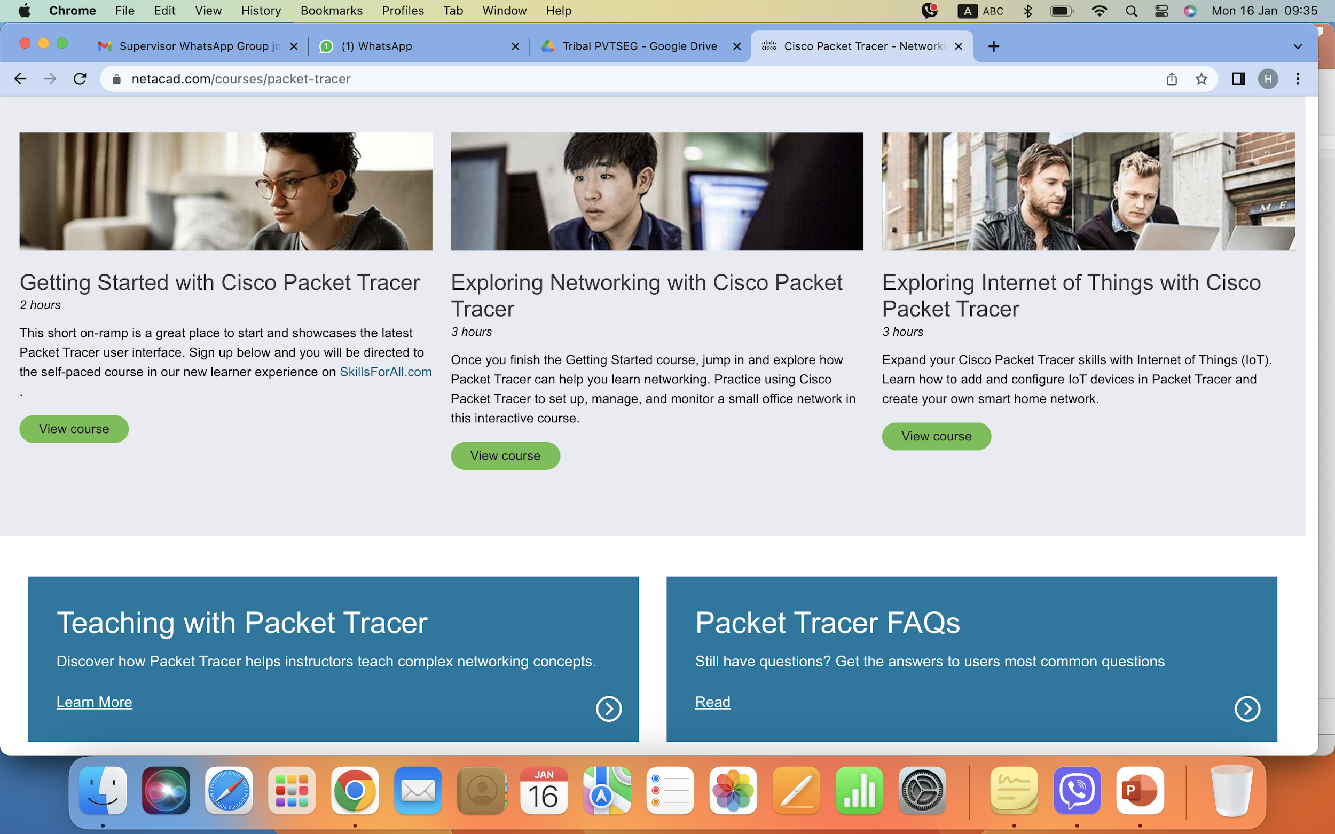
Courses

Slide 11
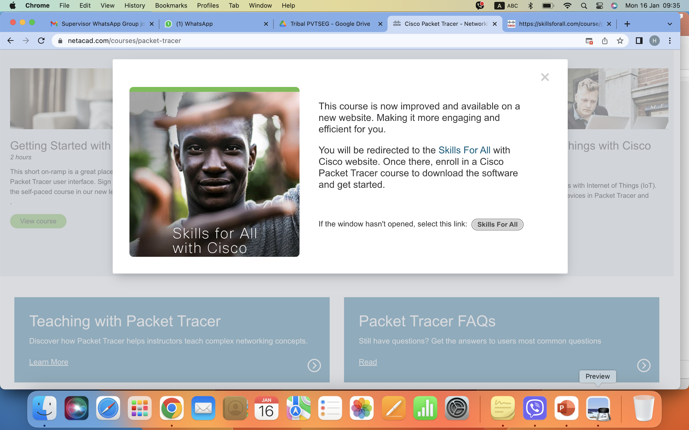
Courses

Slide 12
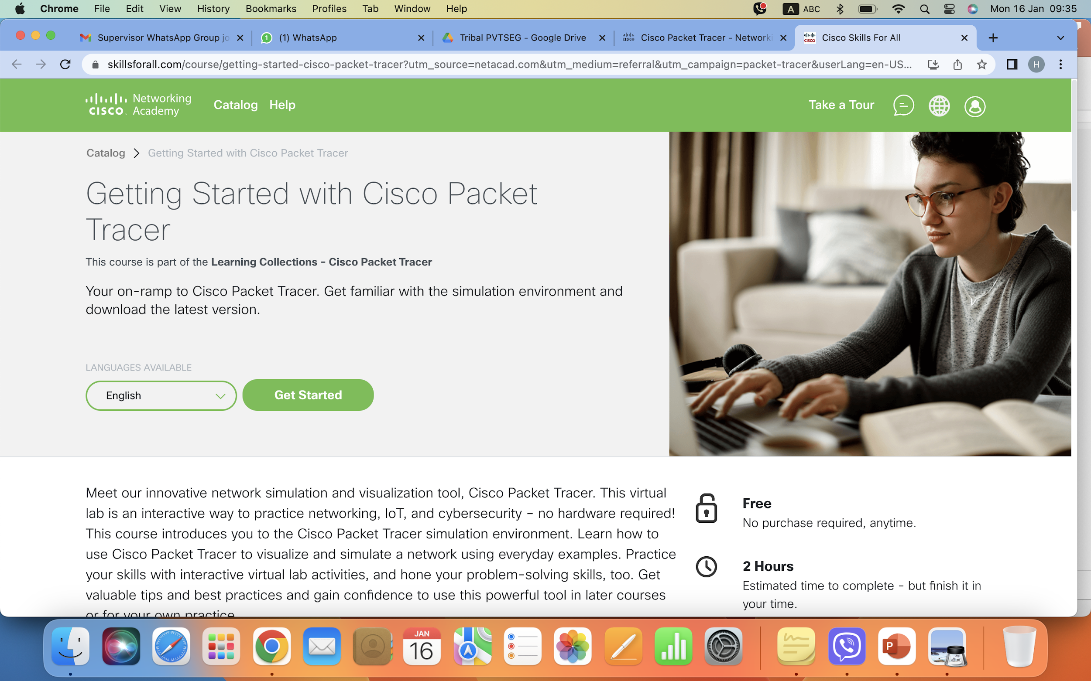
Courses

Slide 13
Links
https://www.netacad.com
https://www.netacad.com/portal/resources/packet-tracer
https://skillsforall.com/launch?id=9762b32d-0a49-4d7a-b881-498eb3be42cc

Slide 14
Thank you

